Slide 1
PF PROJECT
DANEYA SHAFIQ(24K 3037)
ERFA KASHIF(24K 3010)
ANSHRAH SHAFIQUE(24K 3092)

Slide 2
INTRODUCTION
The student management system is an integrated solution for managing student information, storing data and generating relevant files. This program demonstrates structured programing and dynamic memory allocation functionalities in the systems. This student program manages data over different sections and subjects. It enables data entry, modification and retrieval of data.This management system has adapted its features from flex.

Slide 3
KEY FEATURES
Parent Menu Module
GPA and Report Management Module
Data Input and Modification Module
Cleanup and Memory Management Module
File Handling Module
Teacher Interface
Student Interface
Parent Interface
Main Menu Module
Teacher Menu Module
Student Menu Module

Slide 4
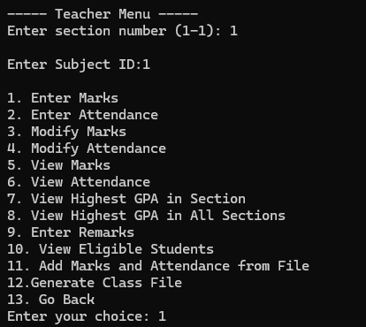
TEACHER INTERFACE
Enter, view, and modify student marks and attendance records.
Add remarks for students to provide personalized feedback.
Generate detailed class reports for performance analysis.
Identify students with the highest GPA within a section or across sections.

Slide 5
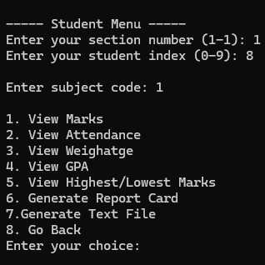
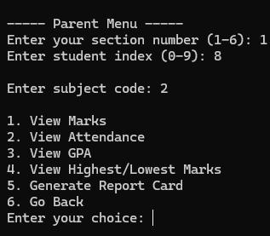
STUDENT INTERFACE PARENT INTERFACE

Slide 6
GPA & REPORT MODULE
Purpose:
Handle GPA calculation, identifies high achievers, and generates detailed reports.
Functionality:
Calculates GPA for each student using the pre-defined formula:
(We have pre-defined the formulae as per FAST curriculum) GPA=0.3×Midterm Marks+0.2×Classwork Marks+0.5×Final Exam MarksGPA=0.3×Midterm Marks+0.2×Classwork Marks+0.5×Final Exam Marks.
Identifies the highest GPA in a section and across all sections. Similar to award distribution ceremony at FAST
Generate textual reports for individual students and entire classes. Enables the teacher to have an idea about the section they teach at a glance.
Module Name:
void viewHighestGPA(Student ***students, int section, int NUM_STUDENTS, int subIndex)
void viewHighestGPAAllSections(Student ***students, int NUM_SECTIONS, int NUM_STUDENTS, int subIndex)
void generateTextReport(Student ***students, int section, int studentIndex)
void generateClassfile(Student ***students, int section, int NUM_STUDENTS, int subIndex)

Slide 7
Data Input and Modification Module
Purpose:
Allows teachers to input and update student data such as marks, attendance, and remarks.
Functionality:
Enables entering marks for all or specific students.
Updates attendance records and ensures inputs are within valid ranges (e.g., 0–100% does a validation to check if the input is correct or not).
Adds remarks to student profiles for specific subjects(acts as a private comment to student).
Modifies existing data with a error-checking mechanism.
Module Name:
void enterMarks(Student ***students, int section, int NUM_STUDENTS, int subIndex)
void modifyMarks(Student ***students, int section, int NUM_STUDENTS, int subIndex)
void enterAttendance(Student ***students, int section, int NUM_STUDENTS, int subIndex)
void modifyAttendance(Student ***students, int section, int NUM_STUDENTS, int subIndex)
void enterRemarks(Student ***students, int section, int NUM_STUDENTS, int subIndex)

Slide 8
Cleanup and Memory Management Module
Purpose:
Ensures efficient use of resources by properly deallocating dynamically allocated memory or else if we do not free the memory it will cause performance issues.
Functionality:
Frees memory allocated for students, sections, and GPA arrays.
Prevents memory leaks by ensuring all pointers are properly deallocated before exiting the program.
Module Name:
void cleanup(Student ***students, int NUM_SECTIONS, int NUM_STUDENTS)

Slide 9
FILE HANDLING
Purpose:
Facilitates persistence of data and generation of archival reports.Acts as report cards given to kids to have an idea about their progress.
Functionality:
Writes detailed performance reports for individual students or entire classes to text files.
Ensures proper file handling with error checking during read/write operations(checks whether the files is NULL).
Module Name:
void generateTextReport(Student ***students, int section, int studentIndex)
void generateClassfile(Student ***students, int section, int NUM_STUDENTS, int subIndex)

Slide 10
Error Handling
Marks and Attendance Module:
Validate marks (0–100) and attendance percentages (0–100).
Ensure correct bulk data formatting.
GPA & Report Module:
Handle file opening errors.
Validate subject IDs for GPA and reports.
Memory Management Module:
Verify successful memory allocation (malloc).
General Validation:
Catch invalid switch cases.
Clear input buffers for invalid entries.
Main Menu Module:
Validate menu choices (1–4).
Handle non-integer inputs via input buffer clearance.
Teacher Menu Module:
Validate section numbers (1–NUM_SECTIONS) and subject IDs (0–NUM_SUBJECTS-1).
Ensure valid teacher menu options.
Student and Parent Menu Module:
Validate section numbers, student indices (0–NUM_STUDENTS-1), and subject IDs.
Ensure valid student//parent menu options.

Slide 11
Thank you
The Student Management System evolved from a simple GPA tracker to a multi-functional system managing academic data for multiple subjects, sections, and users (teachers, students, and parents). It efficiently handles grades, attendance, reports, and uses dynamic memory allocation and user-defined structures for efficient performance.

